Slide 1
Chapter 8 Estimation

Slide 2
Why Estimate?
Research tries to say something about population parameters
Many times we don’t have population data/values
Too time intensive
Too costly
Instead, we use the sample to tell us about the population

Slide 3
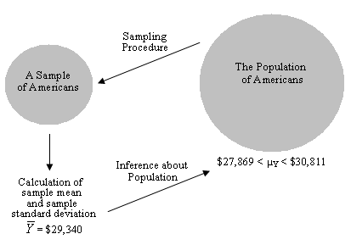
Estimations lead to interferences

Slide 4
Estimation
A process whereby we use a sample statistic to estimate a population parameter
From a sample we can estimate
Population means (and SD/Variances)
Population proportions (and percentages)

Slide 5
Two Types of Estimation
Point Estimates
Interval Estimates
Confidence Interval
Confidence Level

Slide 6
Point Estimate
Point Estimate
A sample statistic used to estimate the exact value of a population parameter
The sample mean
The point estimate of the population mean
The sample standard deviation
The point estimate of population standard deviation

Slide 7
Confidence Interval
Confidence Interval (CI)
A range of values within which the population parameter is estimated to fall
Half the confidence interval is also called the margin of error

Slide 8
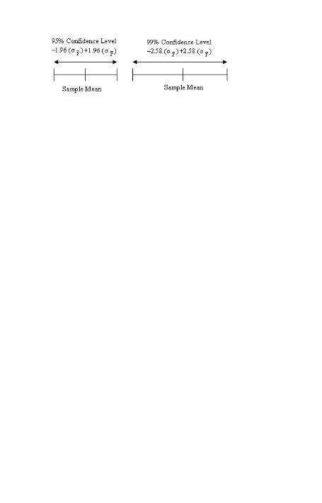
Confidence Interval
We want to construct an estimate of where the population mean falls based on our sample statistics
The actual population parameter
falls somewhere on this line
This is our confidence interval

Slide 9
Confidence Interval
The width of the confidence interval will be determined by the confidence level you choose
Based on the Z score associated with your confidence level

Slide 10
Confidence Level
Confidence Level
The likelihood, expressed as a percentage or a probability, the confidence interval will contain the population parameter

Slide 11
Confidence Level
95% confidence level
There is a .95 probability that a specified interval does contain the population mean
In other words, there are 5 chances out of 100 (or 1 chance out of 20) that the interval does not contain the population mean
You’re willing to be wrong 5% of the time

Slide 12
Confidence Level
99% confidence level
There is 1 chance out of 100 that the interval does not contain the population mean

Slide 13
Confidence Level Corresponding Z Scores
Standard Deviation or Z Score units for various Confidence Levels
68% of all sample means fall within ___ of pop mean
± 1 SD units/Z scores
95% of all sample means fall within ___ of pop mean
± 1.96 SD units/Z scores
99% of all sample means fall within ___ of pop mean
2.58 SD units/Z scores

Slide 14
Constructing Confidence Interval Estimates
Requires
The sample mean (point estimate)
The standard error of the mean of the sampling distribution (point estimate)
The Z score associated with a given confidence level (interval estimate)

Slide 15
Constructing Confidence Interval Estimates
Requires
The sample mean (point estimate)
The standard error of the mean of the sampling distribution (point estimate)
The Z score associated with a given confidence level (interval estimate)

Slide 16
Constructing Confidence Interval Estimates
Requires
The sample mean (point estimate)
The standard error of the mean of the sampling distribution (point estimate)
The Z score associated with a given confidence level (interval estimate)

Slide 17
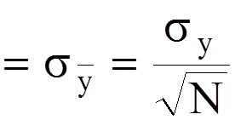
The Standard Error of the Mean
AKA the standard deviation of the sampling distribution
SE Mean

Slide 18
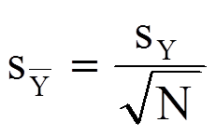
Estimating the Standard Error of the Mean
Because the standard error is generally not known, we work with the estimated standard error

Slide 19
Constructing Confidence Interval Estimates
Requires
The sample mean (point estimate)
The standard error of the mean of the sampling distribution (point estimate)
The Z score associated with a given confidence level (interval estimate)

Slide 20
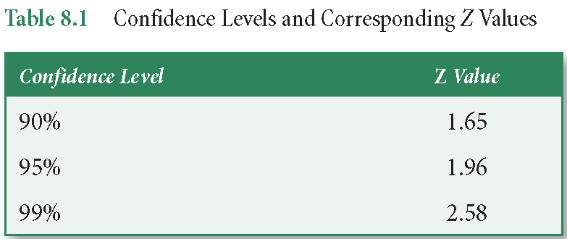
Choosing a Z Score

Slide 21

Calculating a Confidence Interval
where:
= sample mean (estimate of μ)
Z = Z score associated with a confidence level
σ = standard error of the mean of the sampling distribution

Slide 22
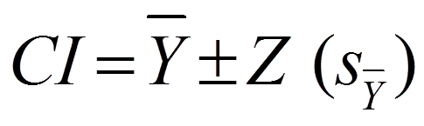
Calculating a Confidence Interval
where:
= sample mean (estimate of μ)
Z = Z score associated with a confidence level
S = estimated standard error of the mean of the sampling distribution

Slide 23
A Note on Confidence Interval Width
Confidence Level
Increasing our confidence level from 95% to 99% means we are less willing to draw the wrong conclusion
If we reduce our risk of being wrong, then we need a wider range of values
The interval becomes less precise

Slide 24
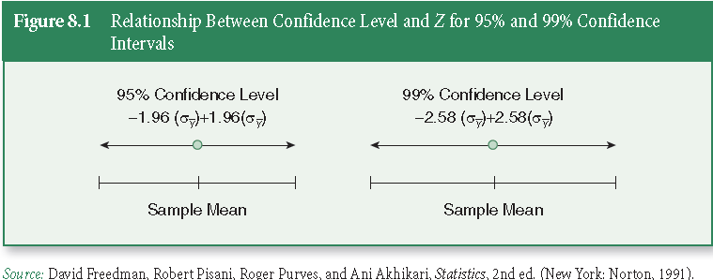
Confidence Interval Width

Slide 25
What Affects Confidence Interval Width?
Sample Size
Larger samples result in smaller standard errors (standard error of the mean of sampling distribution), and therefore, in sampling distributions that are more clustered around the population mean.
A more closely clustered sampling distribution indicates that our confidence intervals will be narrower and more precise

Slide 26
What Affects Confidence Interval Width?
Standard Deviation
Smaller sample standard deviations result in smaller, more precise confidence intervals
Unlike sample size and confidence level, the researcher plays no role in determining the standard deviation of a sample

Slide 27
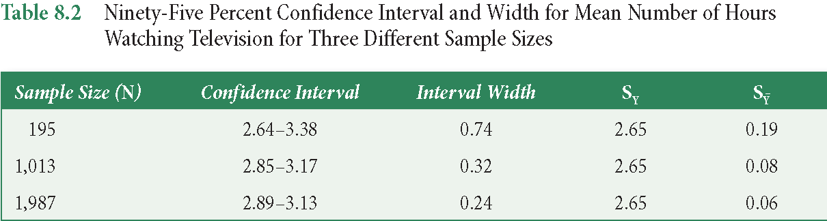
Example

Slide 28
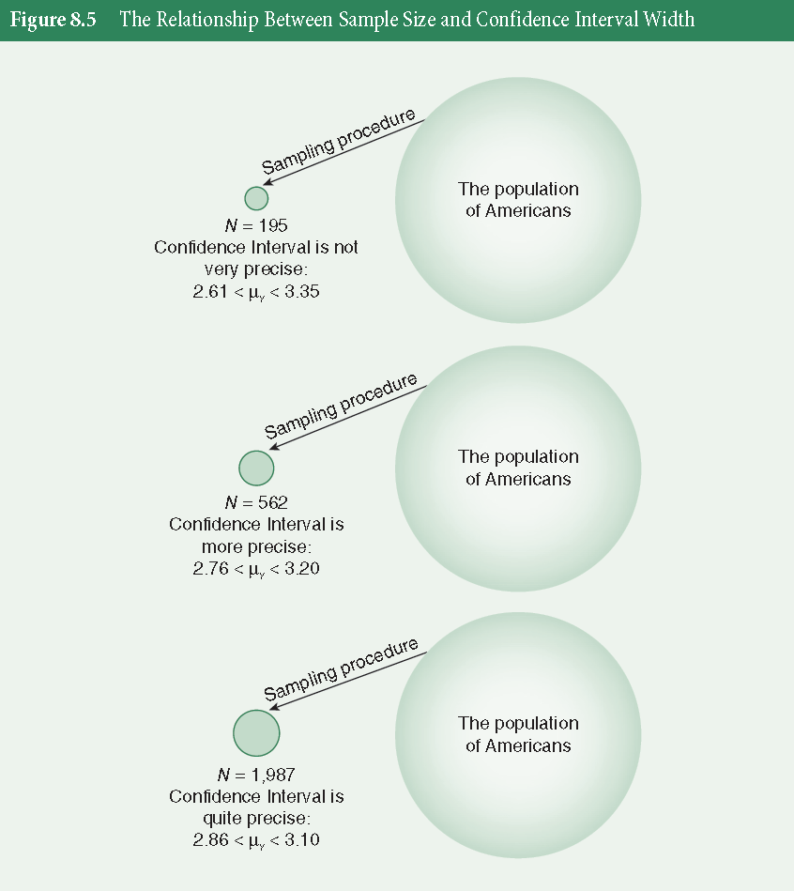
Example

Slide 29
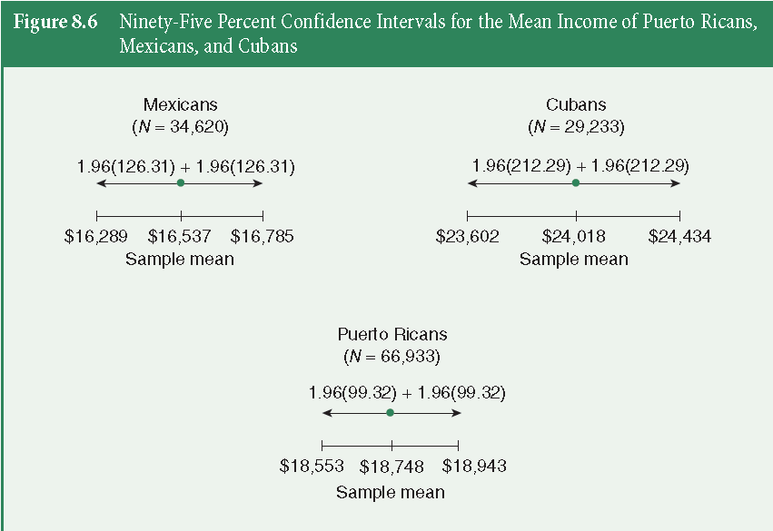
Example

Slide 30
Example: Average Time Commuter Students Spend Commuting
Population of Commuters on Campus = 15,000
Random Sample = 500
Y = 7.5 hours/week
Estimate the Population Mean (μ_{Y}) with
95% CI
99% CI
_

Slide 31
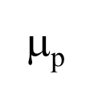

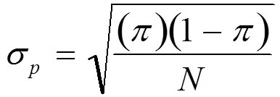
Confidence Intervals for Proportions
Estimating the standard error of a proportion
Based on the Central Limit Theorem, a sampling distribution of proportions is approximately normal, with a mean, , equal to the population proportion, , and with a standard error of proportions equal to

Slide 32
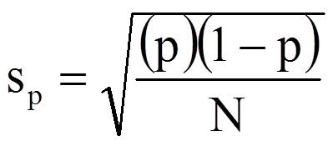
Confidence Intervals for Proportions
Because the standard error of proportions is generally not know, we work with the estimated standard error

Slide 33
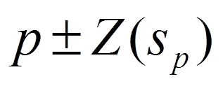
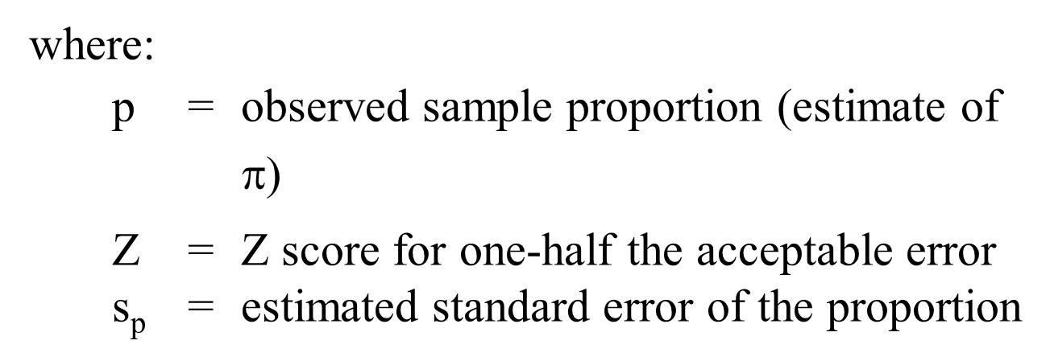
Confidence Intervals for Proportions

Slide 34
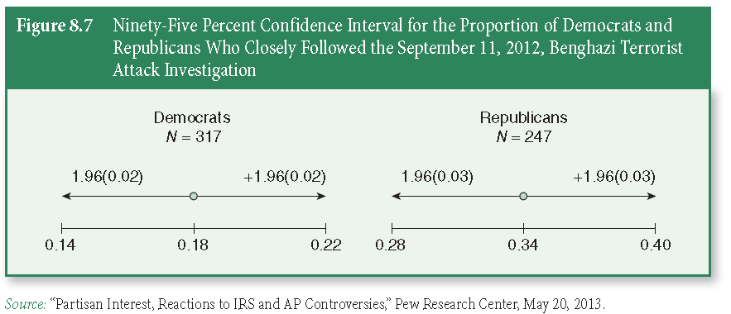
Confidence Intervals for Proportions

Slide 35
Key Terms
Confidence interval (interval estimate)
Confidence level
Estimation
Margin of error
Point estimate

